Slide 2
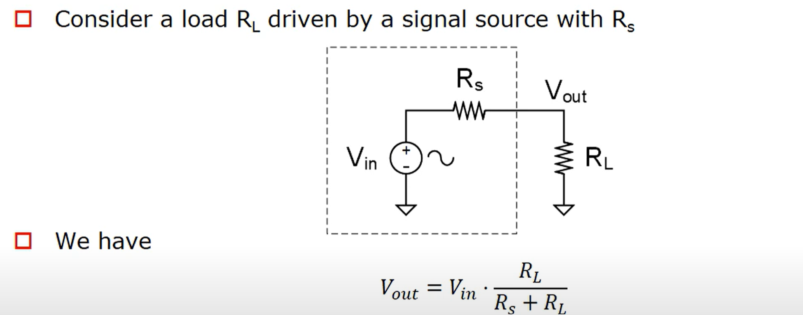
Basic of Restive Load

Slide 3
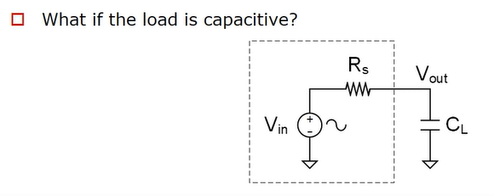
Basic of Capacitive Load

Slide 4
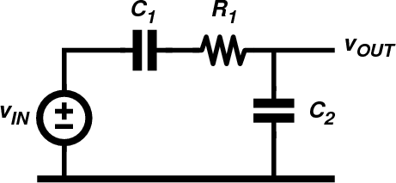

Circuit analysis with phasors and complex impedances
What is the amplitude and phase of the sinusoidal output voltage for C1=10nF, C2=20nF, R1=10kΩ and v_{IN} a sinewave with frequency 1kHz and amplitude 1V?
d ²v
⎛
C ⎞ dv
dv
R C
⎜
⎟
OUT
dt ²
+ 1+
2 OUT
=
IN
dt
1 2
⎜ _{C} ⎟
dt
⎝ 1 ⎠

Slide 5
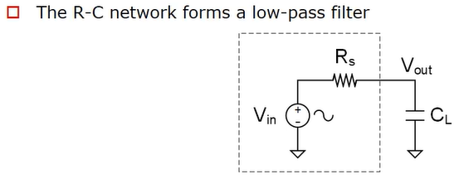
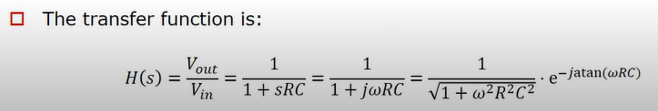
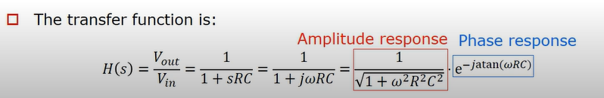

Slide 6
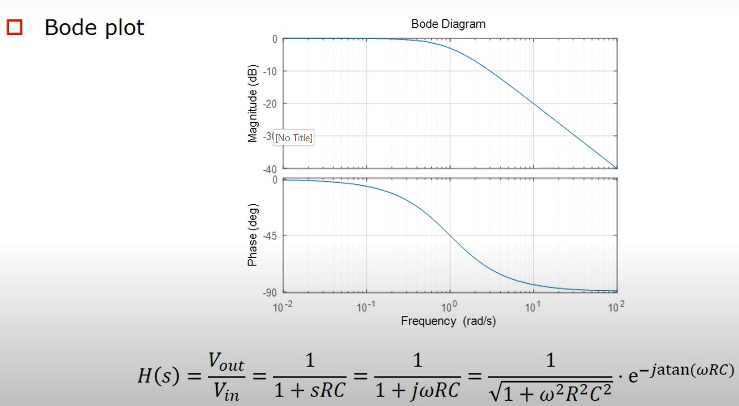
Bode Plot

Slide 7
Circuit analysis with phasors and complex impedances
Assume v_{IN} is sinusoidal and use phasors and impedances
1
Z₁ = R₁ +
jωC
1
1
Z =
2
jωC
2
Indeed, we can just solve this network in the phasor domain. It behaves as a voltage divider, made from impedances. We first write the impedance of Z1 and Z2

Slide 8
Circuit analysis with phasors and complex impedances
Z₂
V = V
IN _{Z}
OUT
+ Z C₁
1
2
1
Using the expressions for Z1 and Z2, we can now easily write the relationship between input phasor (input voltage) and output phasor (output voltage) since this circuit behaves as a voltage divider. The resulting equation is called the transfer function of the circuit (from input to output).
The relationship between input phasor and output phasor is easily found. It is just a complex number. But this complex number depends on the frequency.
= V ⋅
⋅
IN
C + C
C C
1
2
1+ jω ¹ ² R₁
C₁ + C₂
V = V ⋅ (A(ω) ⋅ e ^{jφ (ω )} )
Only one complex number!
OUT
IN

Slide 9
Circuit analysis with phasors and complex impedances
What is the amplitude and phase of the output voltage for C1=10nF, C2=20nF, R1=10kΩ and v_{IN} a sinewave with frequency 1kHz and amplitude 1V?
V = V_{IN} ⋅ (0.2836 − j 0.1188) = V_{IN}
_{0.3075e}− j 0.3967
OUT
𝑣_{𝐼𝑁} = 𝐴 sin( 2𝜋1000𝑡)
𝑣_{0𝑈𝑇} = 𝐴 ⋅ 0.3075 sin( 2𝜋1000𝑡 − 0.3967)
If we plug-in a certain frequency in the expression, we get a complex number that gives the relationship between input and output phasor. We would like to understand the behavior of this circuit for various frequencies.
Output is a sinewave with amplitude of 308mV and initial phase of -0.397 rad (= -22.73 degrees.)

Slide 10
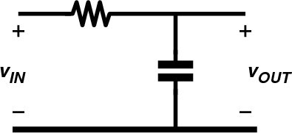
RC low-pass filter
How does this circuit behave for different frequencies?
A simple example of a transfer function is shown on this slide. It is a low pass filter for reasons that will soon become clear.
The transfer function is easily derived. This is indeed a complex number that depends on frequency. By multiplying numerator and denominator by jwC, we obtain a simplified expression with a 1 in the numerator and “1+” in the denominator.
Notice that we also have the product of R and C in that expression, and the units of RC are seconds!
1
^{𝑣}0𝑈𝑇 ₌
𝑍_{𝐶}
j𝜔𝐶
1
=
=
^{𝑣}𝐼𝑁
𝑅 + 𝑍_{𝐶}
_{𝑅 +} 1
1 + j𝜔𝑅𝐶
j𝜔𝐶
𝑟𝑎𝑑
𝜔 ⇒
𝑠
𝑉 𝐶
𝑅𝐶 ⇒ Ω𝐹 = = 𝑠
𝐴 𝑉

Slide 11
RC low-pass filter (2)
How does this circuit behave for different frequencies?
We substitute the expression RC by the time-constant tau, with units in seconds.
Likewise, 1/RC is substituted by the angular frequency omega_c with units
radians/seconds. This new variable omega_C will be called the ‘corner frequency’ of the filter. We can also re-write the expression using frequency in Hz (rather than rad/s).
Note: we will encounter the time constant tau again when we investigate the timedomain behavior of RC circuits.
^{𝑣}0𝑈𝑇 ₌
1
1
1
1
=
=
=
^{𝑣}𝐼𝑁
1 + j𝜔𝑅𝐶
1 + j𝜔𝜏
1 + j ^{𝜔}
𝜔_{𝐶}
1 + j ^{𝑓}
𝑓_{𝐶}
1 𝑟𝑎𝑑
𝜔_{𝐶}
𝑓 = =
1
𝜏 = 𝑅𝐶 𝑠
𝜔 =
𝐻𝑧
𝐶
𝑅𝐶
𝑠
𝐶
2𝜋 2𝜋𝑅𝐶

Slide 12
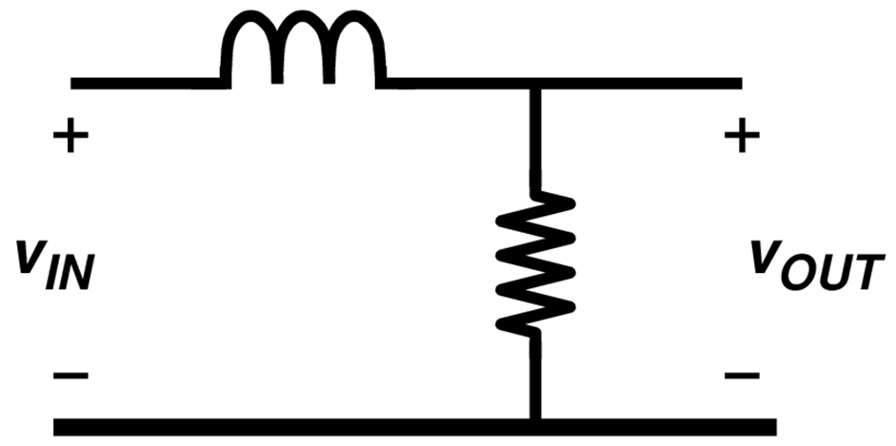
RL low-pass filter
How does this circuit behave for different frequencies?
^{𝑣}0𝑈𝑇 ₌
𝑅
𝑅
1
=
=
^{𝑣}𝐼𝑁
𝑅 + 𝑍_{𝐿}
𝑅 + j𝜔𝐿
1 + j𝜔 ^{𝐿}
𝑅
𝑟𝑎𝑑
𝜔 ⇒
𝐿/𝑅 ⇒ 𝐻/Ω = 𝑠
𝑠

Slide 13
RL low-pass filter (2)
How does this circuit behave for different frequencies?
^{𝑣}0𝑈𝑇 ₌
1
1
1
=
=
^{𝑣}𝐼𝑁
1 + j𝜔 ^{𝐿}
1 + j ^{𝜔}
1 + j ^{𝑓}
𝑅
𝜔_{𝐶}
𝑓_{𝐶}
𝐿
𝜏 =
𝑅 𝑟𝑎𝑑
𝜔 =
𝜔_{𝐶} 𝑅
𝑓 = =
𝑠
𝐶
𝐻𝑧
𝑅
𝐿
𝑠
𝐶
2𝜋 2𝜋𝐿

Slide 14
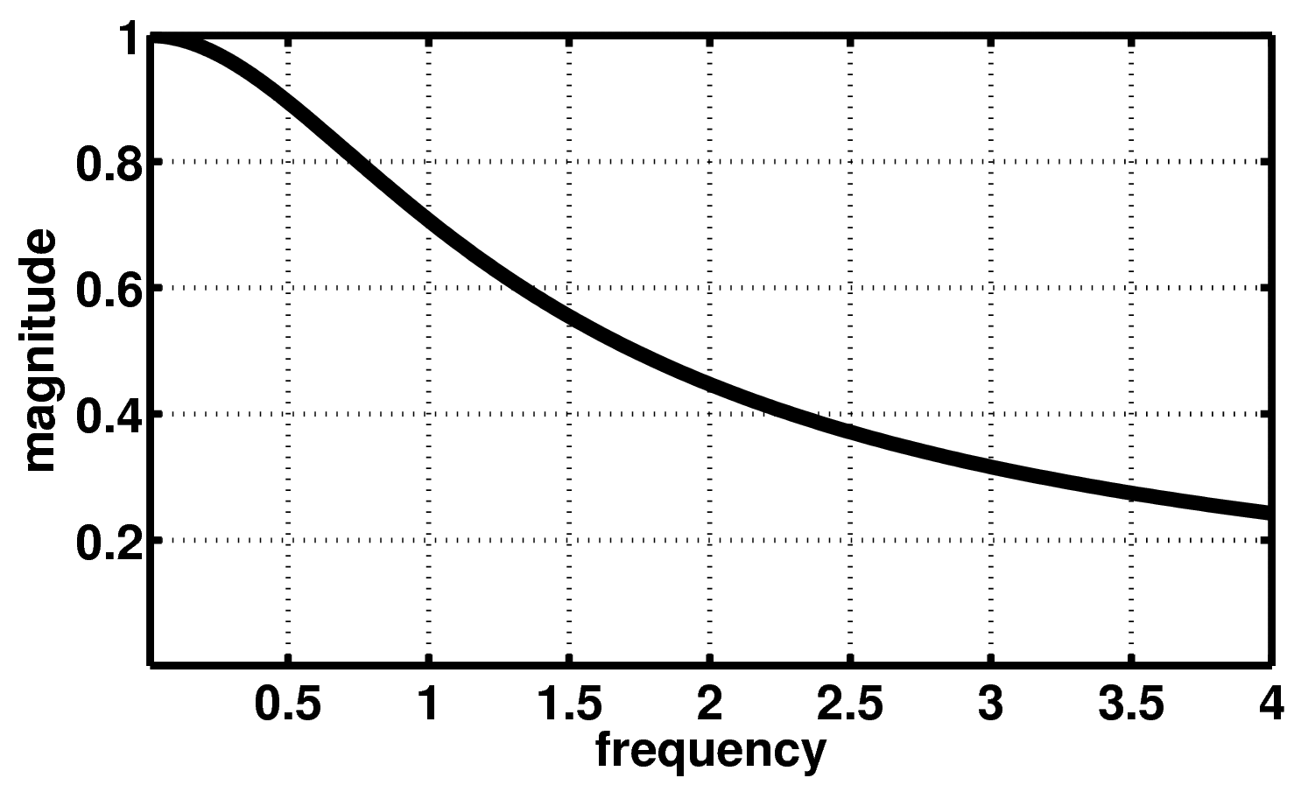
low-pass filter: magnitude
H( jω) = ¹
1
1+ (ω / ω )
f = f_{C} ⇒
H( jω) =
= 0.707
2
2
C
Normalized frequency: f/fc

Slide 15
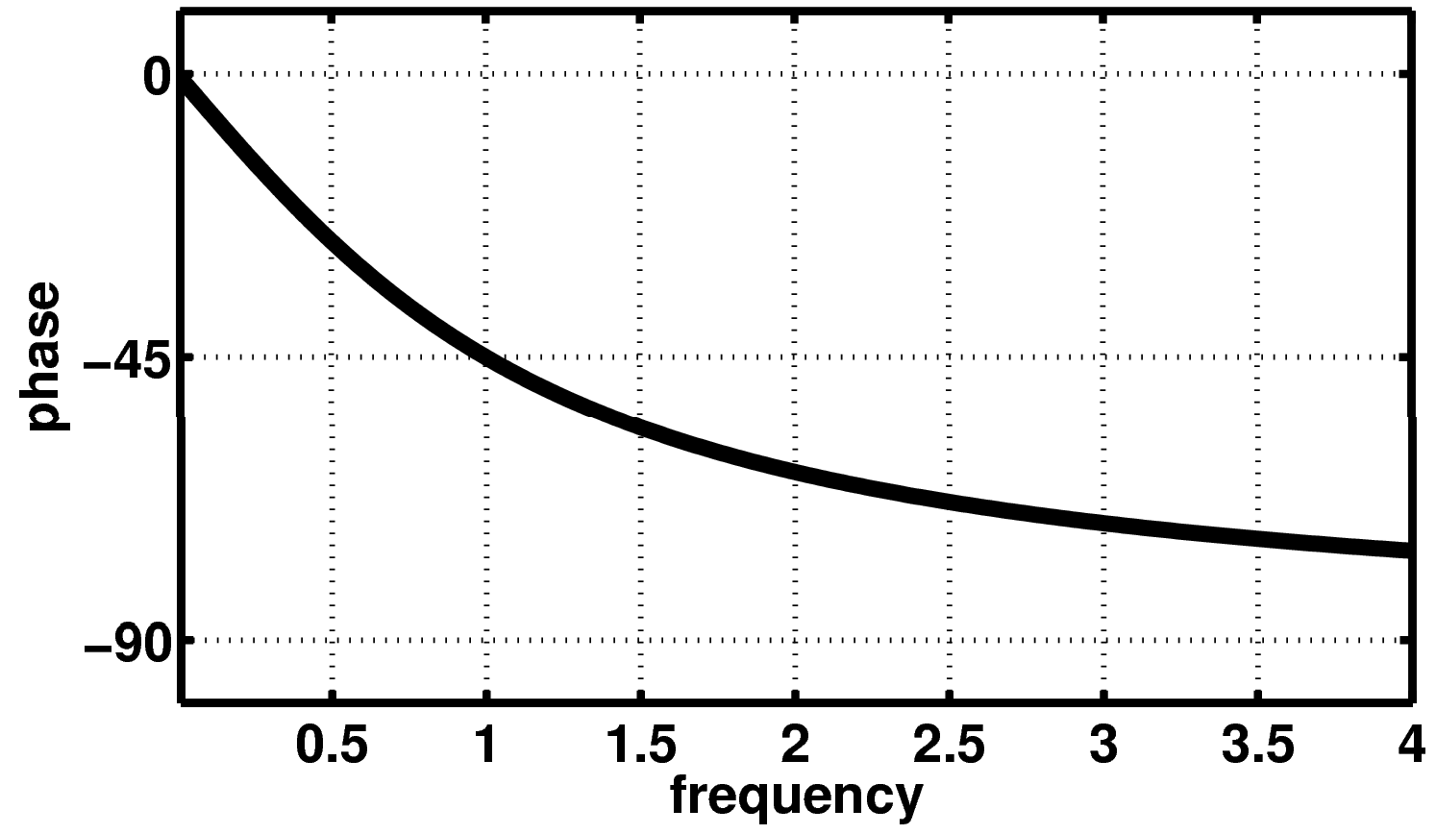
low-pass filter: phase
⎛ ω ⎞
∠H( jω) = 0 − arctan⎜ _{ω} ⎟
f = f_{C} ⇒ ∠H( jω) = −π / 4
⎝ C ⎠
Normalized frequency: f/fc
(

Slide 16
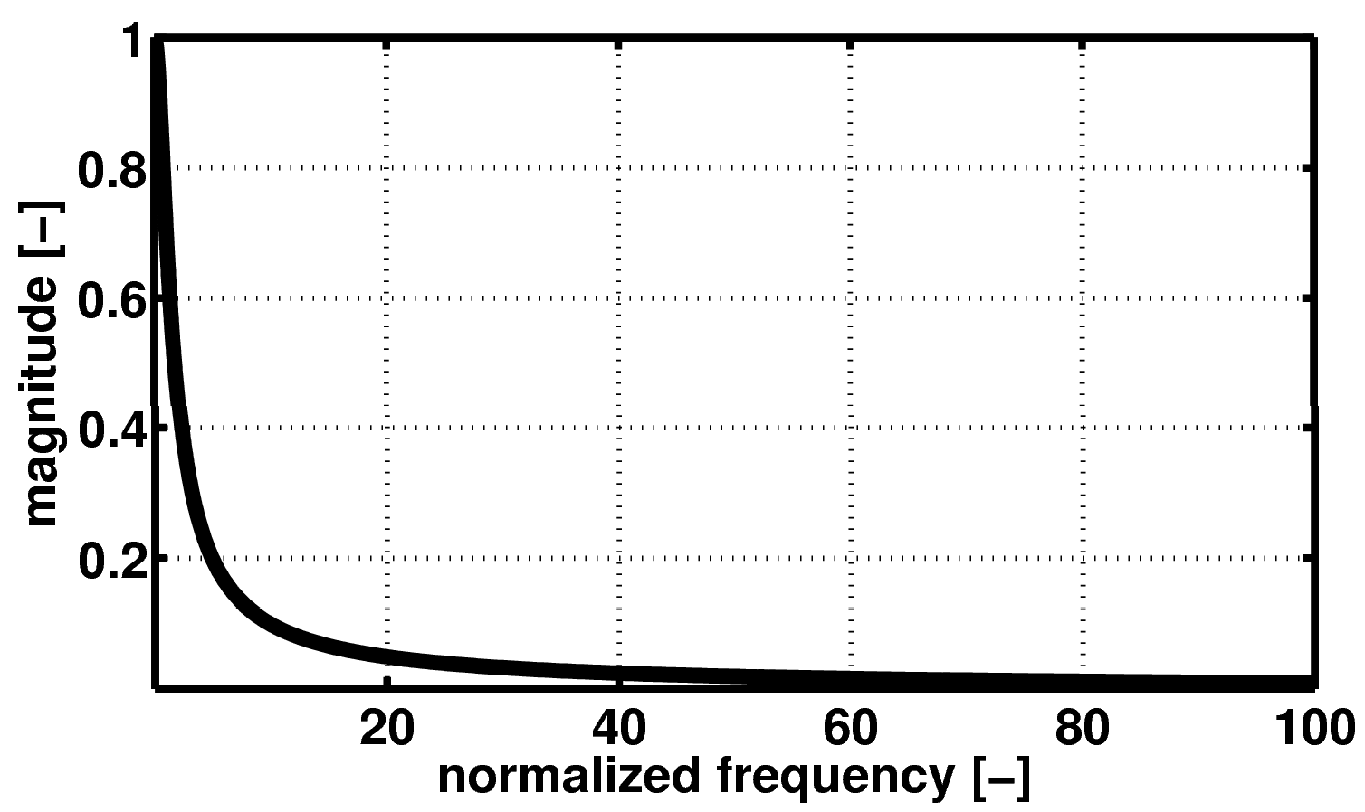
Low-pass filter: magnitude
f/fc

Slide 17
log (10^{x} ) = x
Logarithms
10
log (10^{−x} )= log
10 10
⎛
⎜
^{1 ⎞} = −x
⎟
10
x
⎝ ⎠
log (A )= B log (A)
B
10 10

Slide 18
Benefit of logarithms
1 | ➔ 0
10 | ➔ 1 |  | 0.1 | ➔ - 1
100 | ➔ 2 |  | 0.01 | ➔ - 2
1000 | ➔ 3 |  | 0.001 | ➔ - 3
10000 | ➔ 4 |  | 0.0001 | ➔ - 4
100000 | ➔ 5 |  | 0.00001 | ➔ - 5

Slide 19
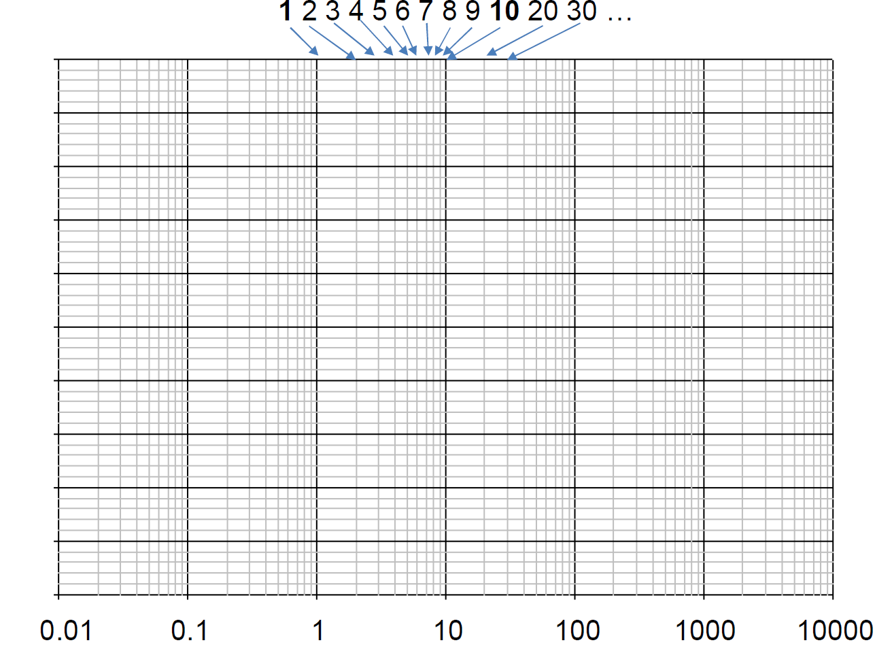
Semilog paper

Slide 20

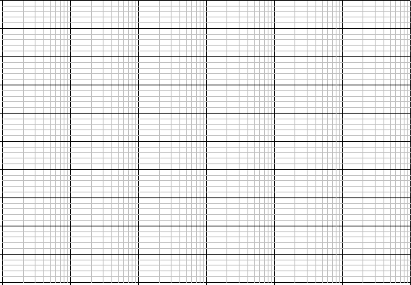
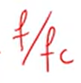
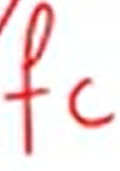
Semilog paper
0.01
0.1
1
10
100
1000
10000

Slide 21
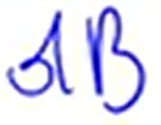
Bell and deciBell
^{⎛ P}OUT ⎞
Bell = log
⎜ ⎟
⎝ IN ⎠
10
P
^{⎛ P}OUT ⎞
dB = 10log
⎜ ⎟
⎝ IN ⎠
10
P
_{⎛V} 2
/ R
⎞
= 10log
⎜
OUT OUT
⎟
10
⎜
⎟
⎝ ^{V}IN^{2 / R}IN ⎠
^{⎛V}OUT ⎞
= 20log
⎜ ⎟
⎝ IN ⎠
10
If R_{OUT} = R_{IN}
V

Slide 22
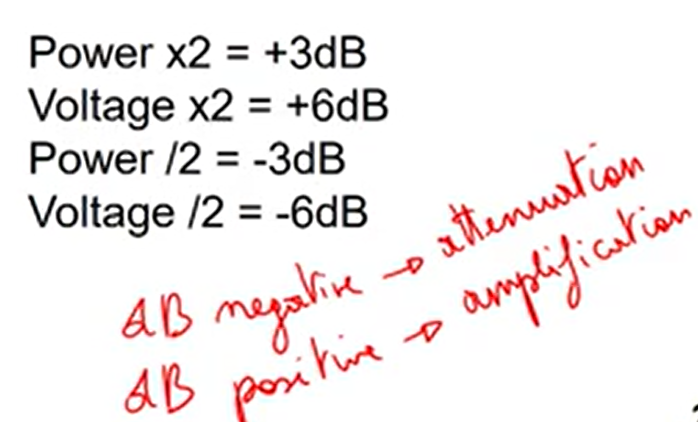
deciBell
(H( jω) )
H( jω)
^{H}dB
H = 20log
dB
10
1
10
0.1
100
0.01
2
4
0.5
2 = 1.414
1 / 2 = 0.707
0dB
+20dB
-20dB
+40dB
-40dB
+6dB
+12dB
-6dB
+3dB
-3dB
Power x2 = +3dB Voltage x2 = +6dB Power /2 = -3dB Voltage /2 = -6dB

Slide 23
dB and dBV
^{𝑉}0𝑈𝑇
𝐻 =
𝐻
= 20 ∙ 𝑙𝑜𝑔 𝐻
𝑑𝐵
10
^{𝑉}𝐼𝑁
^{𝑃}0𝑈𝑇
𝐻 =
𝐻
= 10 ∙ 𝑙𝑜𝑔 𝐻
𝑑𝐵
10
^{𝑃}𝐼𝑁
𝑉_{𝑑𝐵𝑉} = 20 ∙ 𝑙𝑜𝑔₁₀
^{𝑉}𝑅𝑀𝑆

Slide 24
Low-pass filter
( ( ) )
H( jω) = ¹ ⇒ H
= −10log
1+ ω / ω
2
1+ (ω / ω )
2
dB
C
C
f << f_{C} ⇒ H ≈ 1⇒ H_{dB} = 0dB
f = f_{C} ⇒ H = 0.707 ⇒ H_{dB} f >> f_{C} ⇒ H ≈ f_{C} / f ⇒ H_{dB}
= −3dB
= 20log(f_{C} ) − 20log(f )
Sinusoidal signal at input =sinusoidal signal at the output
The frequency is same
The waveform is same
But there is change in Magnitude and phase
₌ ω_{c}
f
C
2π

Slide 25
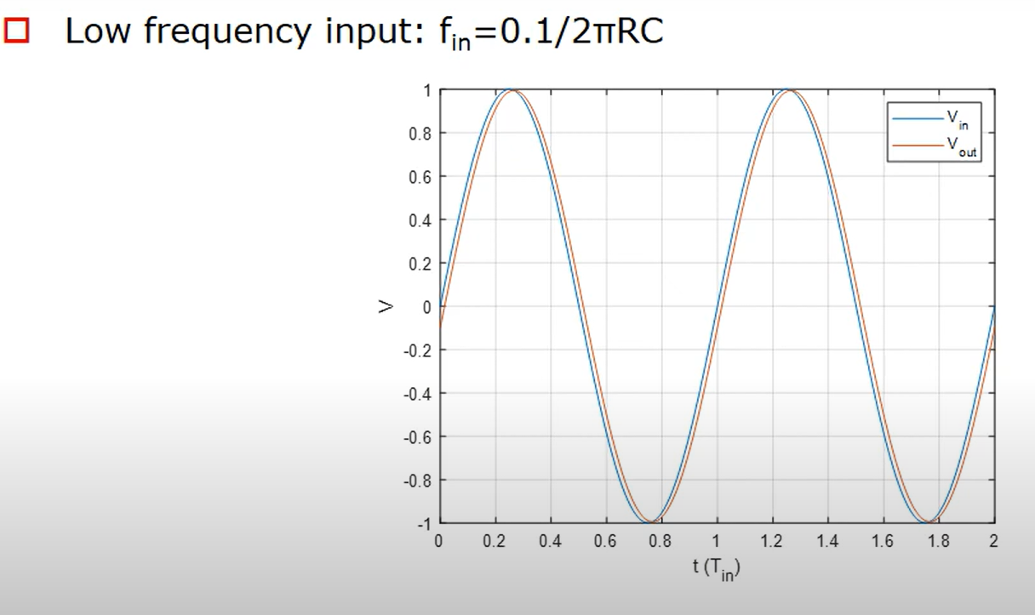
Low Frequency Response

Slide 26
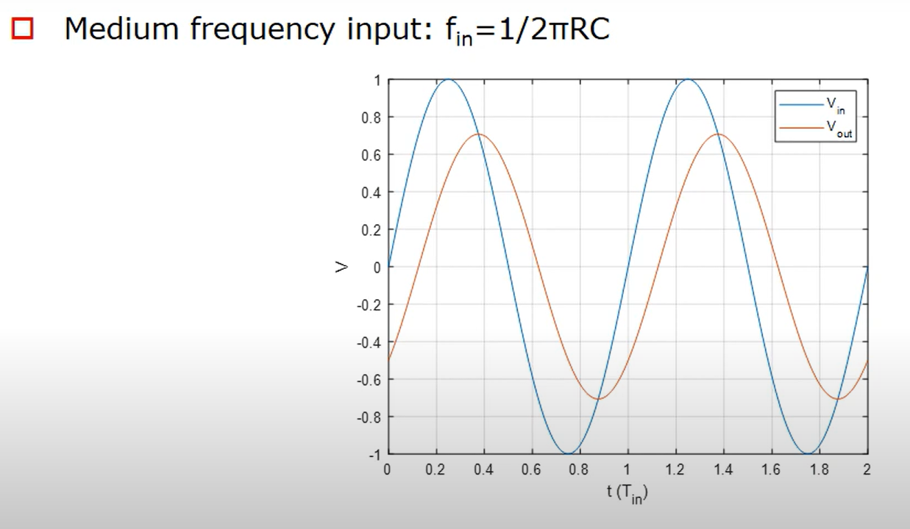
Medium Frequency

Slide 27
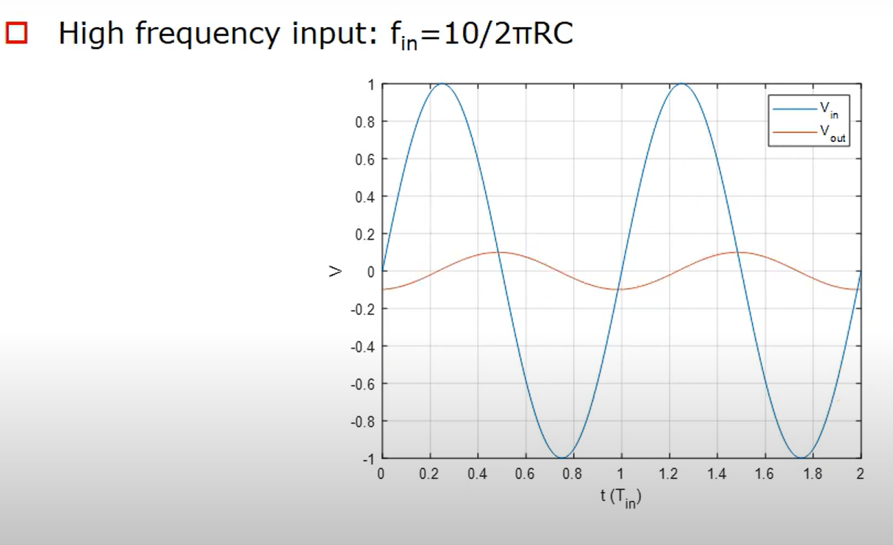
High Frequency

Slide 28
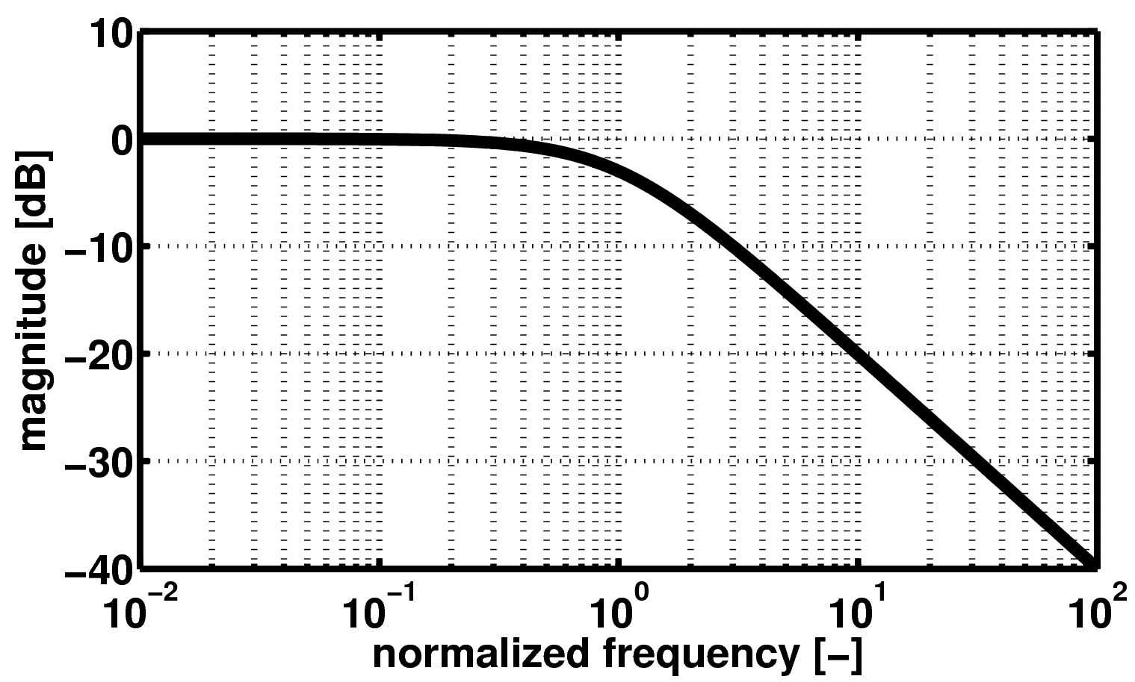
Bode plot - magnitude
0dB
-3dB
-20dB/dec or
-6dB/oct
f/fc

Slide 29
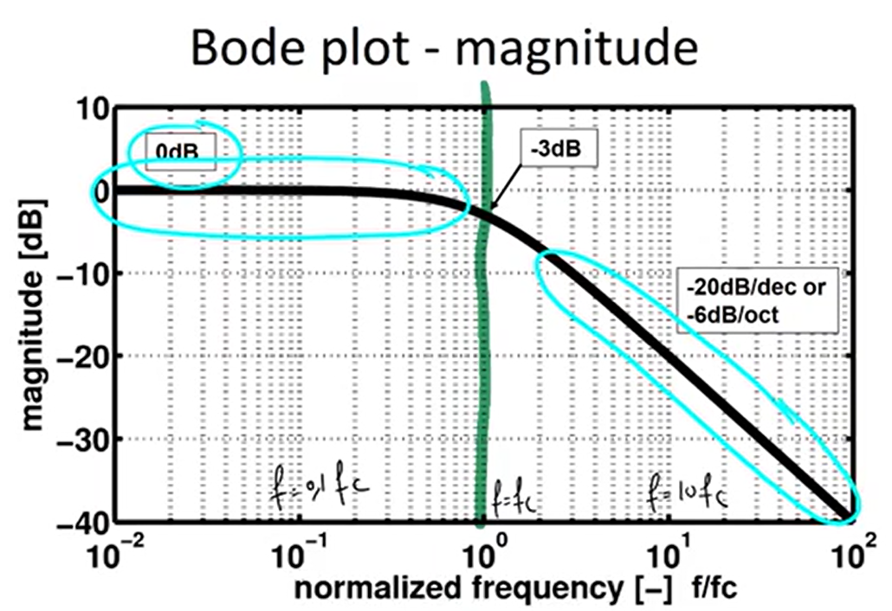
If we increase the frequency by 10, so we multiply the
Frequency by 10, the attenuation increases with 20dB
if the frequency increases by a factor 10

Slide 30
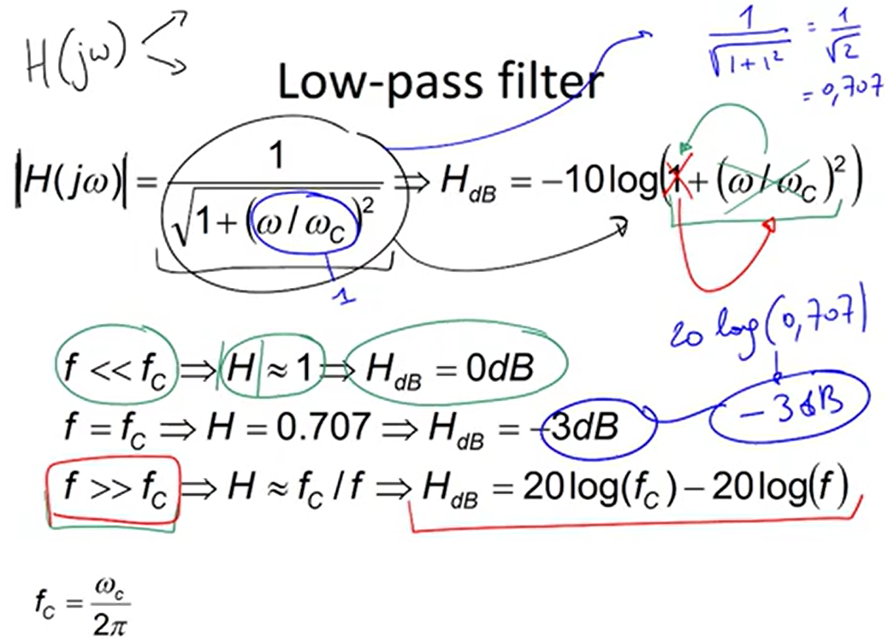

Slide 31
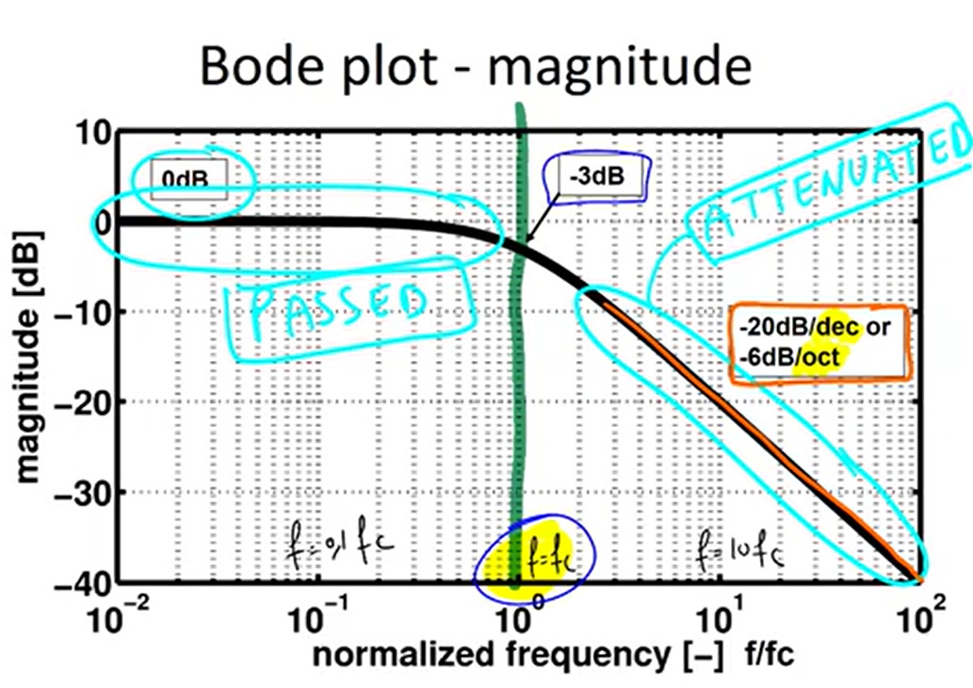

Slide 32
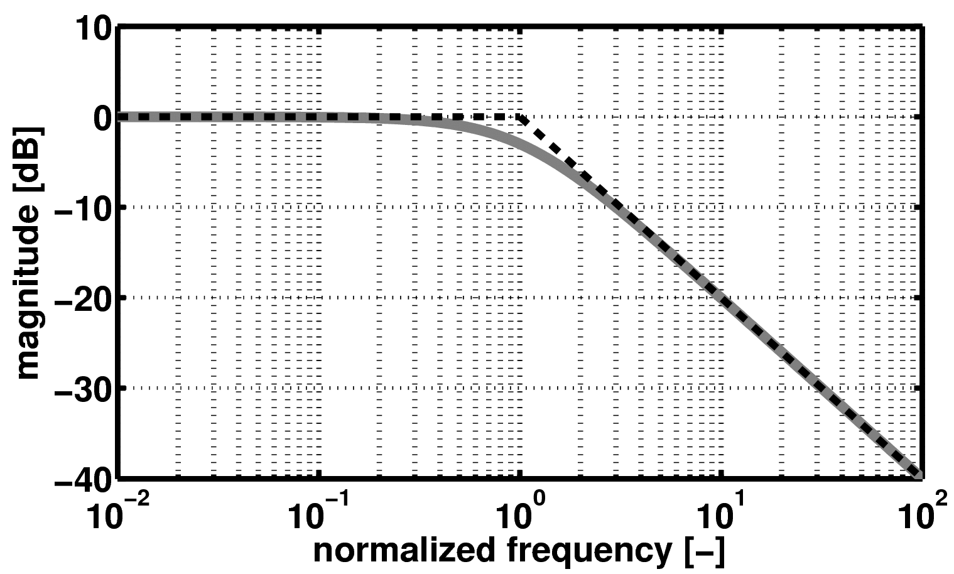
Bode plot – magnitude - asymptotic
Asymptotic approximation
f/fc

Slide 33
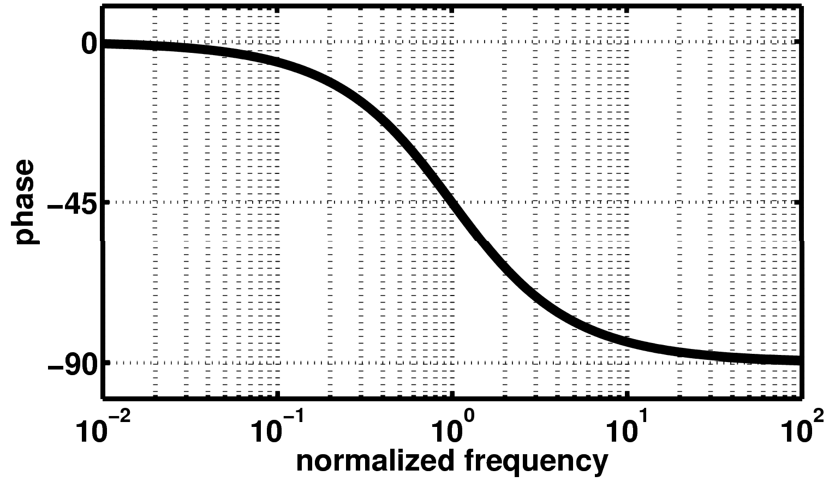
Bode plot - phase

Slide 34
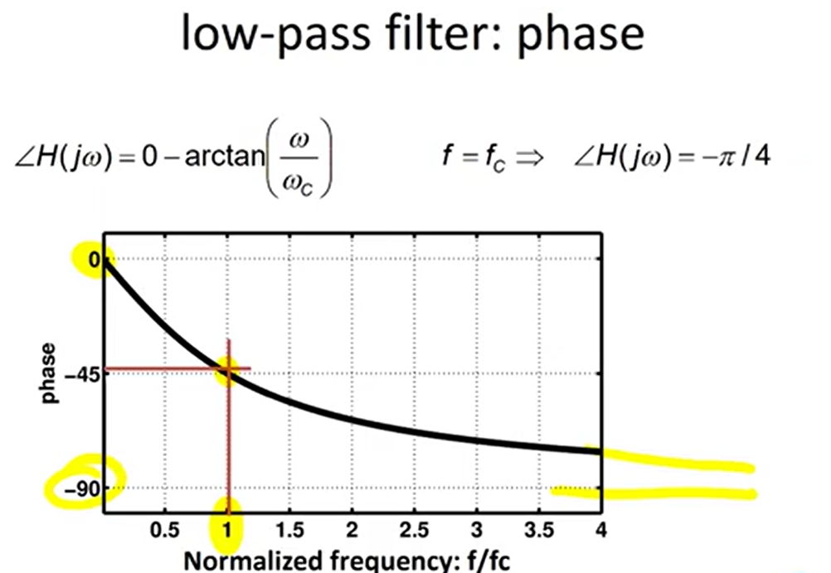

Slide 35
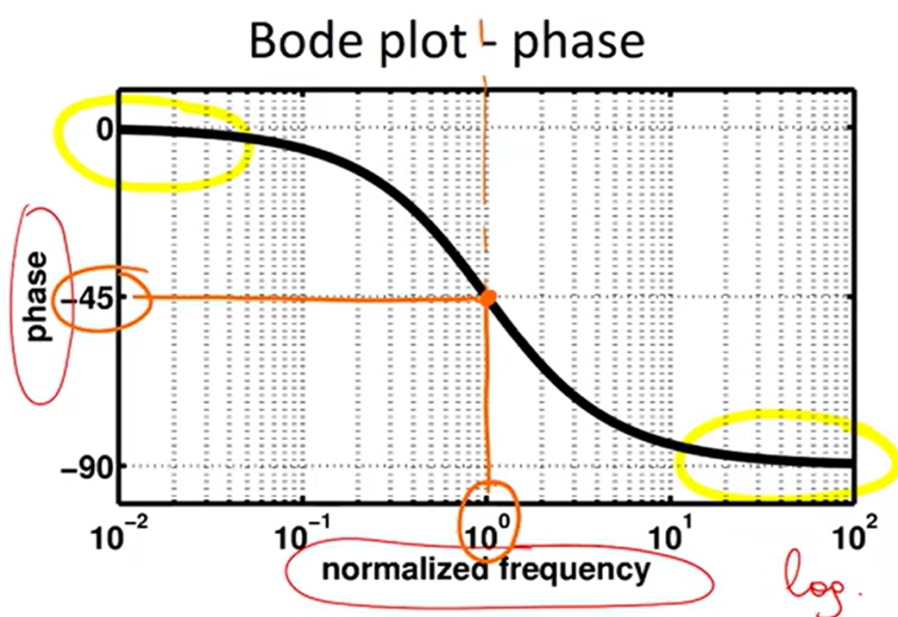

Slide 36
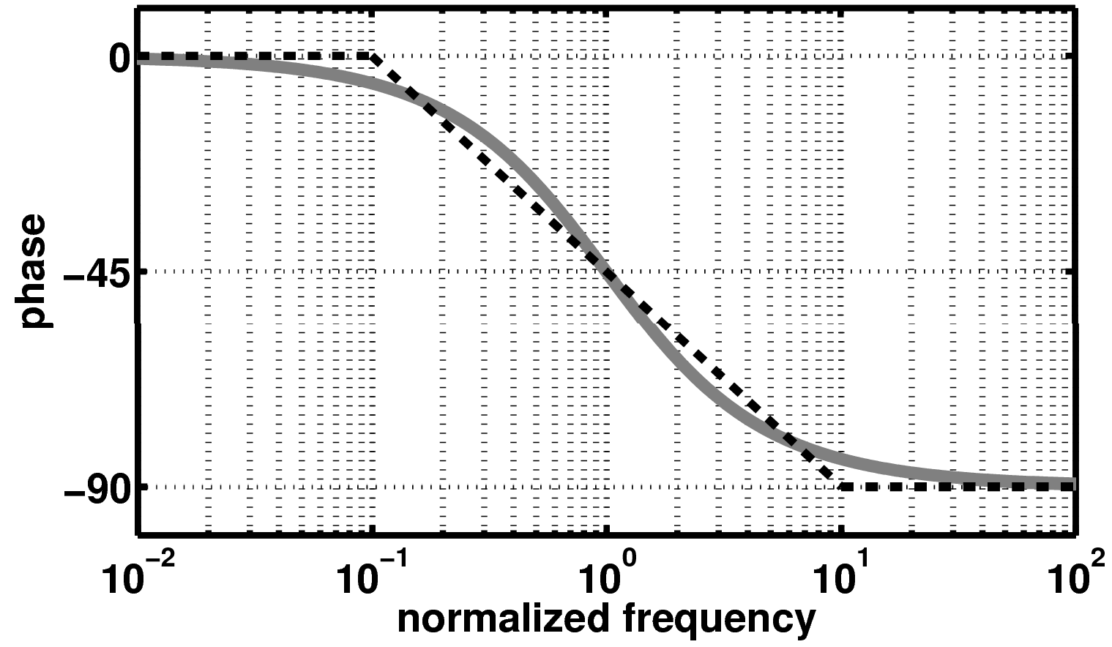
Bode plot – phase - asymptotic
Asymptotic approximation
Asymptotic approximation

Slide 37
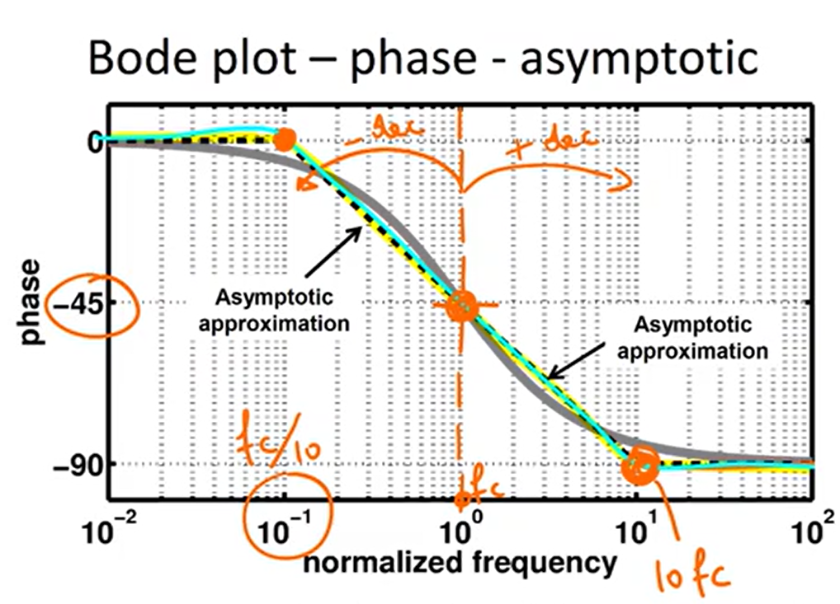

Slide 38
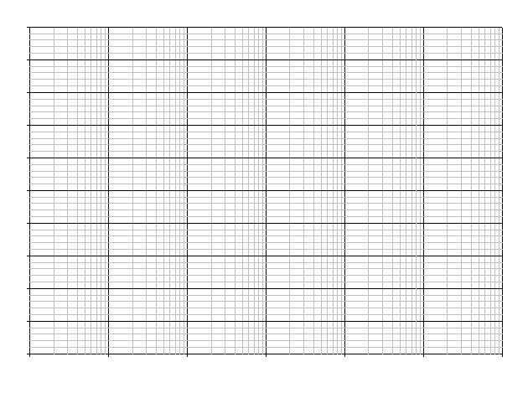
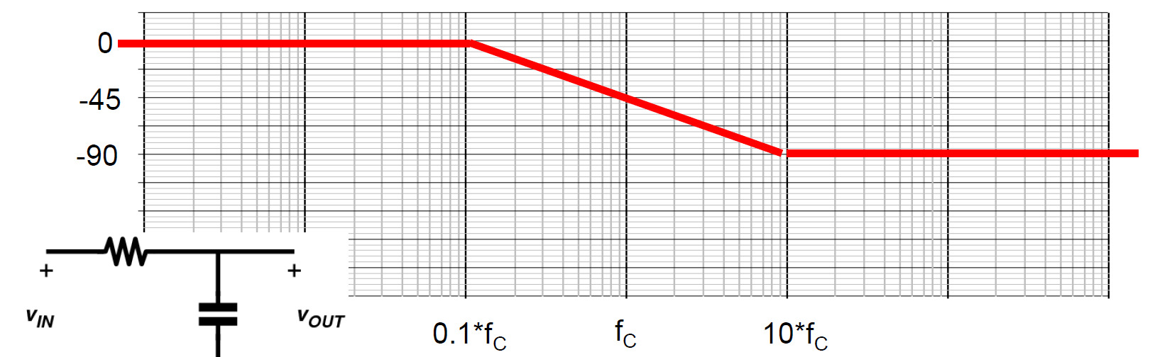
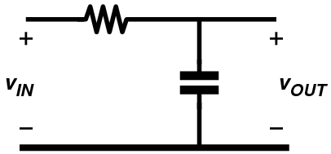
₌ ω_{c}
1
f
=
Low-pass filter
C
2π 2πRC
H( jω) =
1
+20dB
0dB
-20dB
-40dB
1+ j ^{ω}
ω_{C}
-3dB frequency or corner frequency
-60dB
0
-45
-90
0.1*f_{C}
f_{C}
10*f_{C}

Slide 39
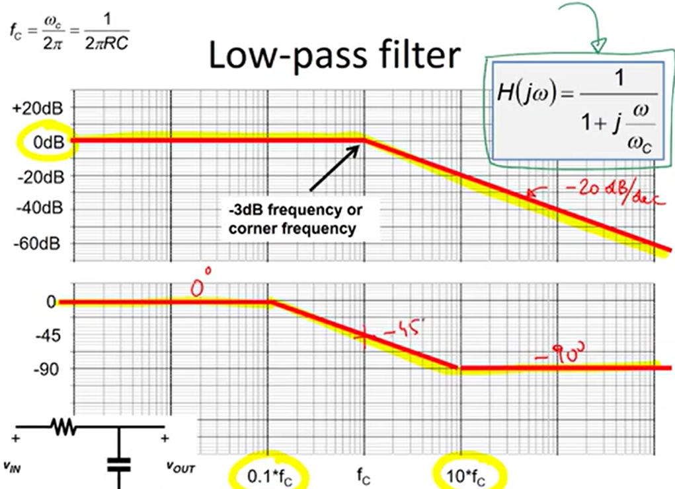

Slide 40
Bode-plot vs. time
+20dB
0dB
-20dB
-40dB
-60dB
0
-45
-90
10Hz
100Hz
1kHz
10kHz
100kHz

Slide 41
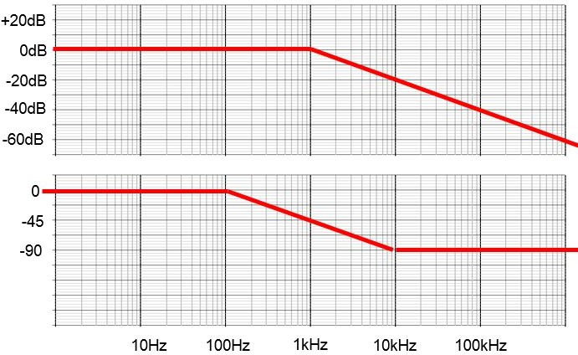
Bode-plot vs. Time domain
Assume: input voltage = sinewave with 1V amplitude and 100Hz frequency.
Output voltage = ?
0dB ➔ output amplitude is the same as input amplitude 0 degree ➔ output phase is the same as the input phase

Slide 42
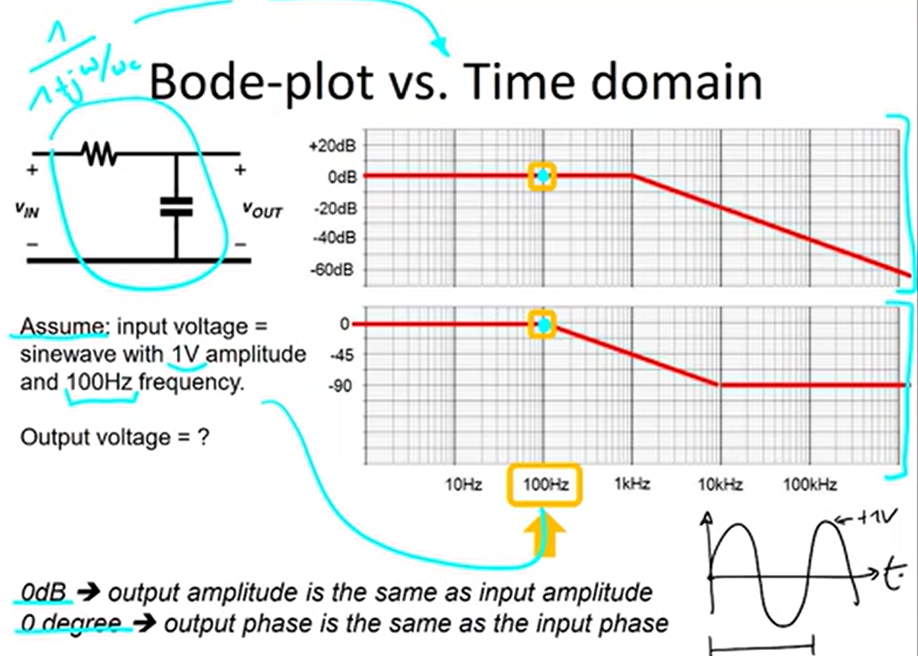

Slide 43
Bode-plot vs. Time domain
Assume: input voltage = sinewave with 1V amplitude and 1kHz frequency.
Output voltage = ?
-3dB ➔ output amplitude attenuated by 0.707 ➔ 0.707V amplitude
-45 degree ➔ output phase is -45 degrees compared to input phase

Slide 44
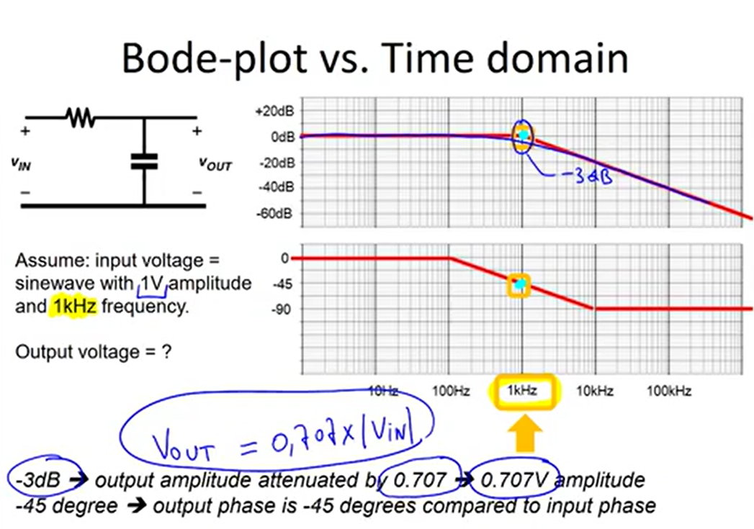

Slide 45
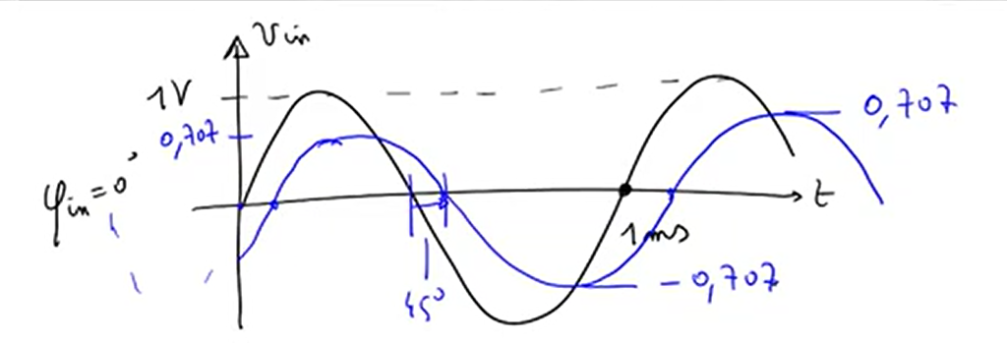

Slide 46
Bode-plot vs. Time domain
Assume: input voltage = sinewave with 1V amplitude and 10kHz frequency.
Output voltage = ?
-20dB ➔ output amplitude attenuated by 0.1 ➔ 0.1V amplitude
-90 degree ➔ output phase is -90 degrees compared to input phase

Slide 47
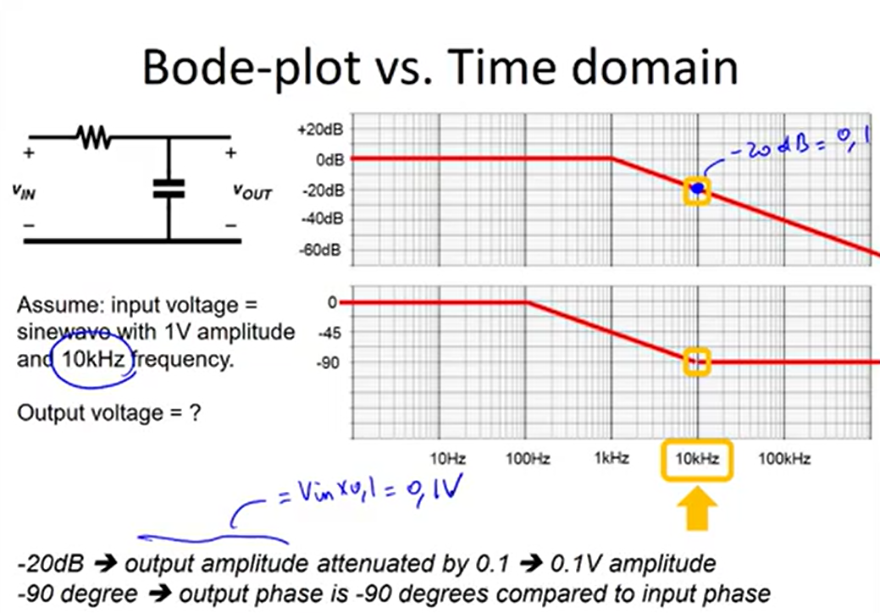

Slide 48
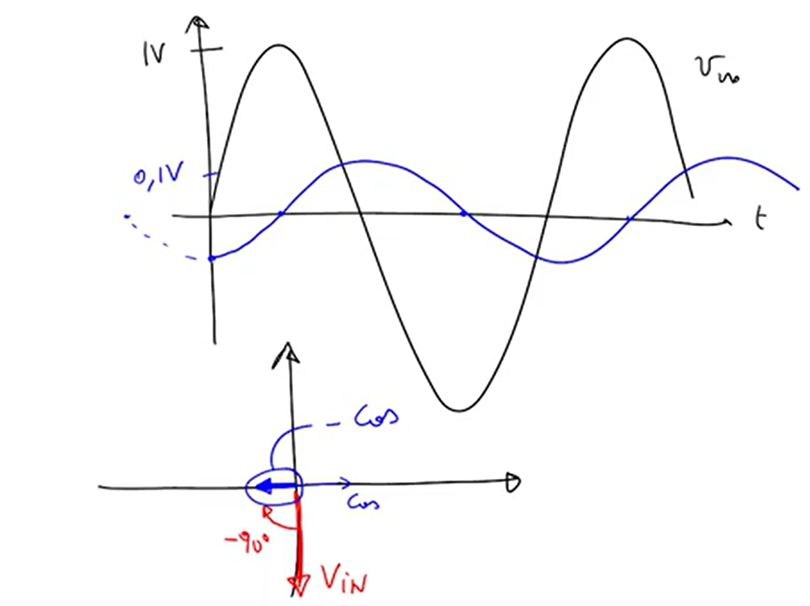

Slide 49

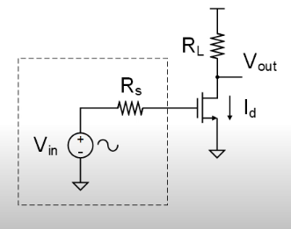
Common Source amplifier

Slide 50
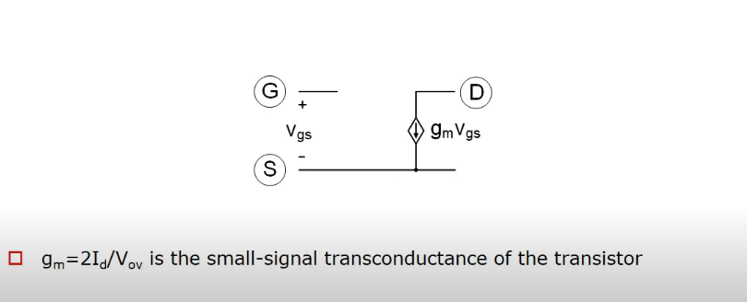
1st Order Small Signal Model (Active Region)

Slide 51
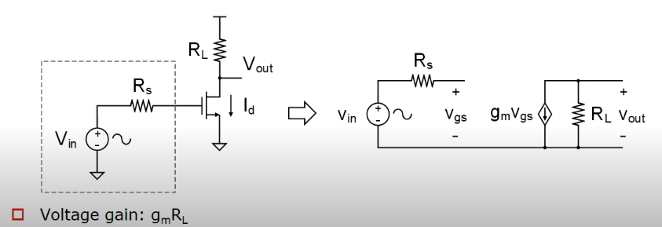
Common Source Amplifier

Slide 52

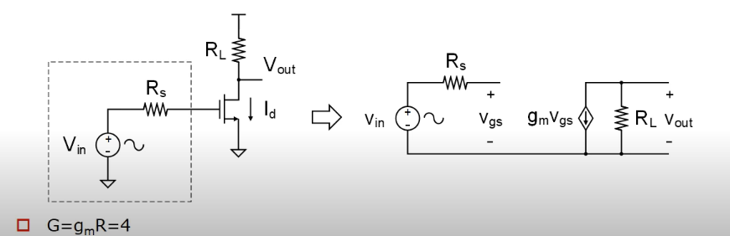

Slide 53
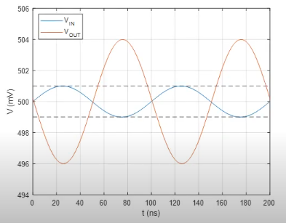
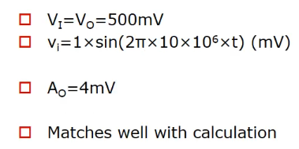

Slide 54
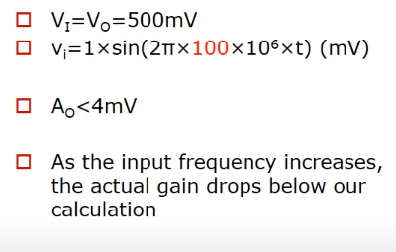
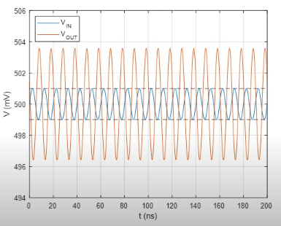

Slide 55
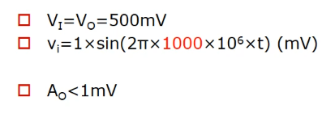


Slide 56



Slide 57


Transistor in Triode Region

Slide 58


Transistor in Active region

Slide 59


Transistor Off

Slide 60

Intrinsic MOS Capacitor summary

Slide 61


Common Source amplifier revisited

Slide 62

Frequency Response

Slide 63

Extrinsic Capacitance

Slide 64

Overlap Capacitance

Slide 65

MOS Capacitor Summary

Slide 66

Common Source amplifier revisited

Slide 67

Bandwidth Estimation

Slide 68

Millar Approximation

Slide 69

Modified Input Network

Slide 70

Improved Bandwidth estimate

Slide 71

Assumptions Check

Slide 72

Effect of output Loading (1)

Slide 73

Effect of output Loading (2)

Slide 74

Zero Time constant Analysis

Slide 75

Example (1)

Slide 76


Example (2)

Slide 77

Bandwidth estimation based on ZVCT

Slide 78


Inclusion of CL

Slide 79

How ZVTCs works

Slide 80



Life without feedback

Slide 81




Life with feedback (1)

Slide 82




Life with feedback (2)

Slide 83




Why better than wire

Slide 84




From output to input

Slide 85


Virtual ground for high linearity

Slide 86

Virtual ground for high linearity

Slide 87
Virtual ground for wider bandwidth

